Slide 1

SUDOKU
Members:
Yufei Ding Kai Chen Sitong Feng
Yiqun Peng Chao Tian

Slide 2
SUDOKU
Description：
Sudoku is a logic game that uses paper and pen to perform calculations. Players need to infer the numbers of all remaining spaces according to the known numbers on the 9 × 9 disk, and satisfy that the numbers in each row, column, and thick line house (3 * 3) all contain 1-9, not repeated
Our team mainly focused on E for “Engaging” , “Easy to learn” and “Error tolerant”. We want our game is friendly for starters and make them feel happy in the process of decryption.
We want our users feel relax when they relax when they first try this mathematical game. We have the most easy level for the start so that they will not loss their confidence at the beginning.

Slide 3
SUDOKU
How to make ‘E’： We let players choose the difficulty they want, so that novice players can achieve the purpose of learning through the simplest problems.
We reduce the number of cases where there is no solution for generating sudoku.
We provide a hint function so that players can get help when they have no way to continue
We collect the data of players every time they play, so that players can understand their progress and deficiencies.
Players can get feedback every time they successfully crack a problem

Slide 4
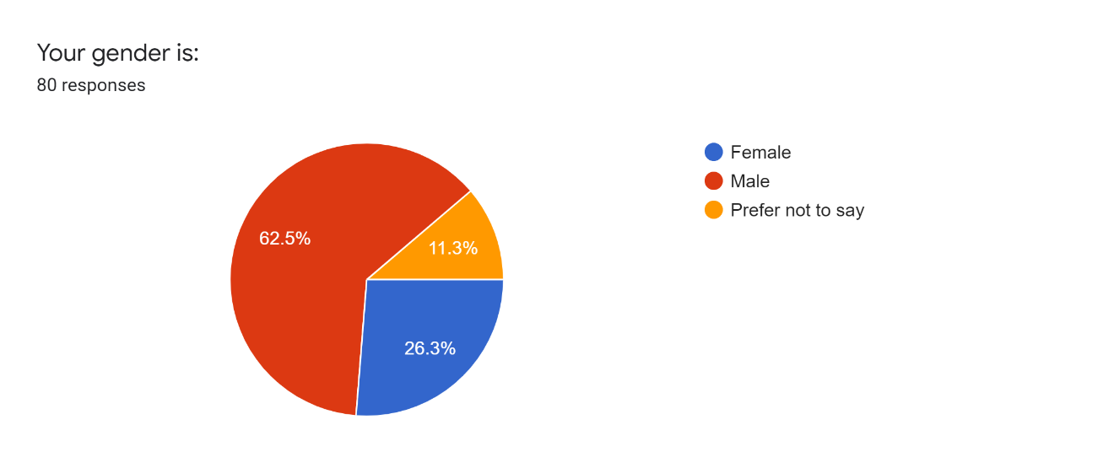
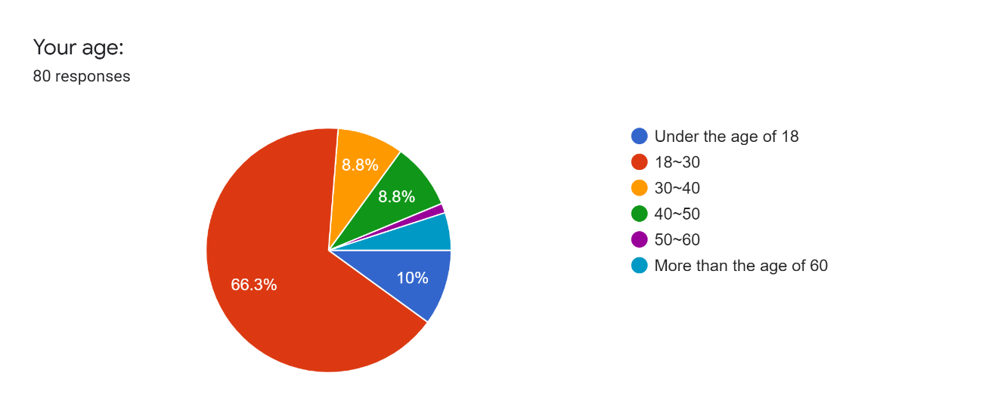
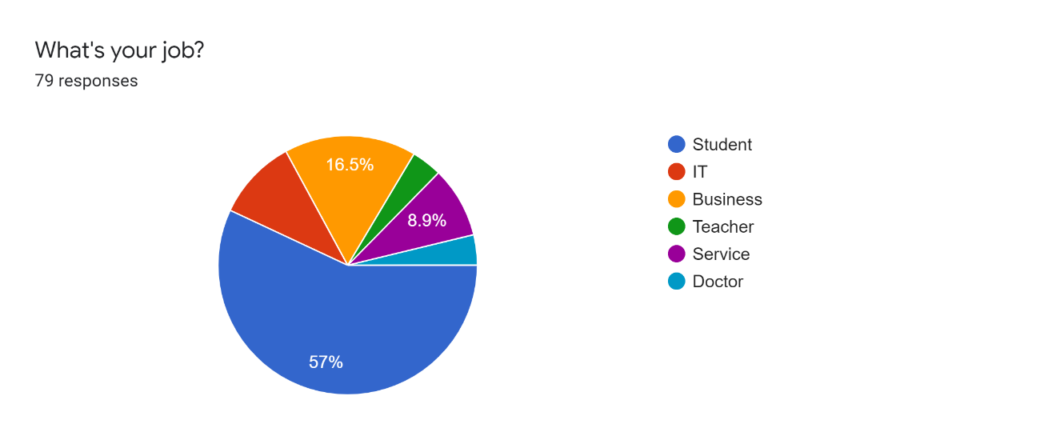
SUDOKU
Target Population:
In order to determine the target population, we did a survey.
It can be seen from the statistical data that young men under the age of 30 prefer the game of Sudoku.
From the third professional statistics table, we can get that the student group prefers Sudoku games.
Among the remaining work groups, those who work in IT and finance prefer Sudoku games.
People who spend time playing the game, and who know Sodoku, are more likely to experience it

Slide 5
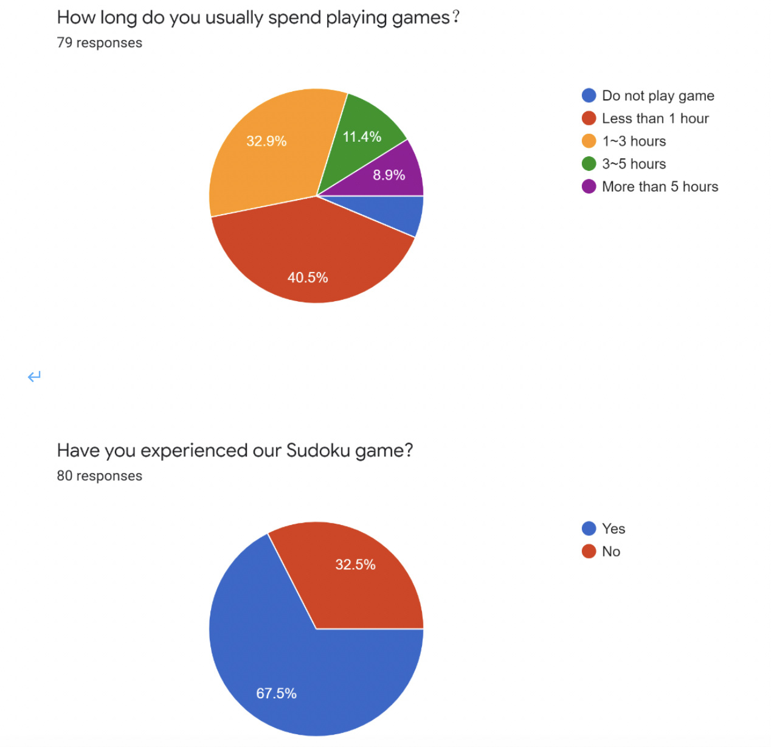
SUDOKU
Target Population:
In order to determine the target population, we did a survey.
It can be seen from the statistical data that young men under the age of 30 prefer the game of Sudoku.
From the third professional statistics table, we can get that the student group prefers Sudoku games.
Among the remaining work groups, those who work in IT and finance prefer Sudoku games.
People who spend time playing the game, and who know Sodoku, are more likely to experience it

Slide 6
SUDOKU
Target Population： All ages can play Sudoku and choose the difficulty according to your needs.
The student community and young people who have just entered work are more inclined to this game. Because they have more leisure time.
For those who have a stable job, those who work in technology and economics prefer Sudoku games. Because they often deal with math problems.
People with sodoku experience are more likely to experience the game because they know the rules and are interested in them.
We also define the elderly group as our target group, because we think Sudoku game can make the elderly think more quickly

Slide 7
SUDOKU
User story:
As a Sudoku player, I highly recommend this game. Because it can increase your sense of Numbers, develop intelligence, exercise your logical ability. I hope this product can have a good beginner tutorial for beginners, so it is more friendly to novices. After I have a deep understanding of this product, I hope that after I learn a simple Sudoku problem, I can freely choose the difficulty of the Sudoku problem I want to challenge and can see the time spent solving each problem. This way I can see my progress and deficiencies and get feedback.
At the same time, I hope that this game will not take up too long for me, after all, this is an intellectual labor. So I hope that when I encounter difficulties, the system can give me the prompts I deserve so that I can quickly solve the current problem

Slide 8
SUDOKU
Typical users:
Wuxu is a typical user. He is a computer major in Stevens. He spends more than two hours a day studying math and computers, and he has to earn nine credits each semester. Because of the Corona virus, his school was still online, he can only stay at home every day. He has two to three hours of recreation every day, apart from taking class and doing homework and doing housework. When we introduced him to sudoku, he was very interested. He said he had played the game on paper book before, and if it had a good guide, he would try it because it would exercise his logical thinking and help him improve his numeracy. And he has free time to play games every day.

Slide 9
SUDOKU
Typical users:
Zhaojie is a 28-year-old civil servant in China. He has to get up at 7 every morning to catch the subway, which takes him an hour on the way. In the process, he always felt very boring, sometimes he chose to read e-books, sometimes he played games. Likewise, he came home from work. His work is easy and unchallenging. He is busy on Mondays and Fridays and spends 2-3 hours a day doing nothing. He complained to us that if he worked like this day in and day out, he might get Alzheimer's disease. When I recommended the sudoku game to him, he was very interested. He thought he could use the game to kill his boredom. He played single-player Sudoku on Nokia and Samsung phones when he was very young, but the question Banks of those games were too small, and he often does what he has already done. He wants the product to have the following features: a friendly tutorial for beginners, different difficulty modes, a large number of question Banks, a timing function, and a ranking function.

Slide 10
SUDOKU
First design:
We played many sudoku games developed by other companies and made simple interface prototypes.
This version of the game is basically functional, but there is no popular interface and perfect interactive buttons.
No error prompt function, no mouse click typing function, only three difficulty options, the user can not see the hint.

Slide 11
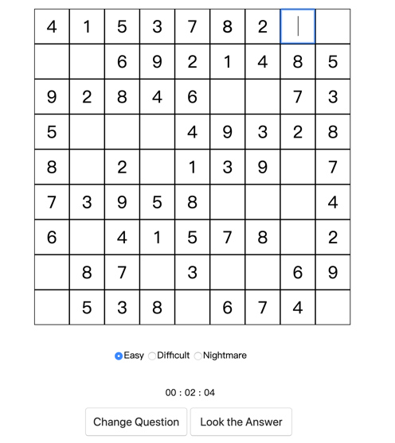
SUDOKU
First Edition:
Primary E :
1.Reduce the number of cases where there is no solution for generating sudoku.
2.We will use some rules to design the game properly.
（Eg：Consecutive three rows, three columns and three houses are not a hint of the number of the problem must be more solutions. In the disk at the same time two less and more Numbers of the problem must be more solutions. There must be more than 5 blank rows, blank columns or blank white houses. Hints less than 17 “basically” are multiple solutions.)

Slide 12
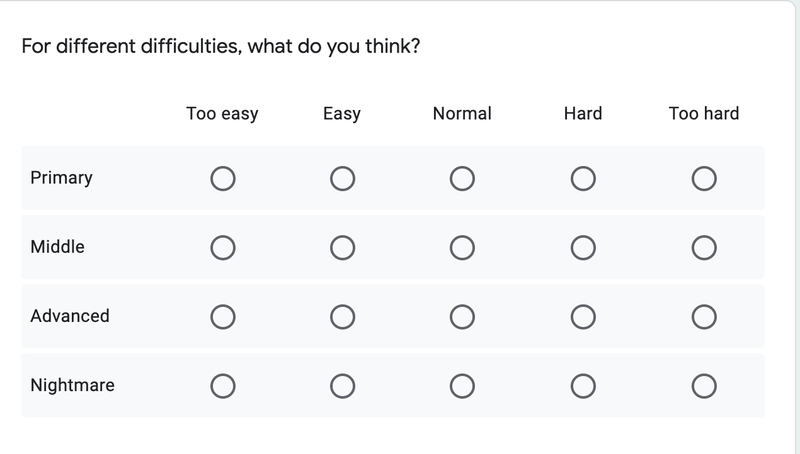
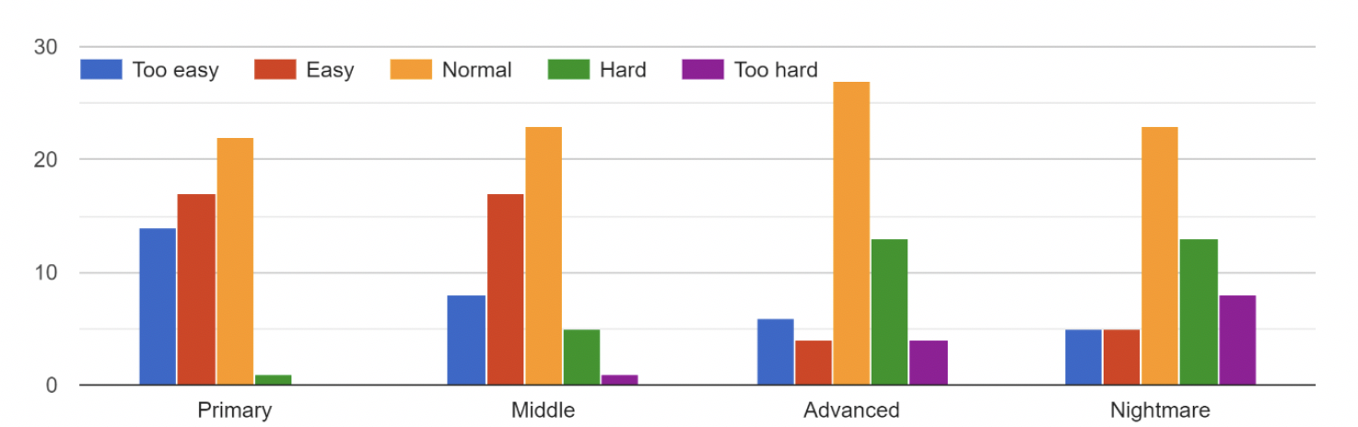
SUDOKU
First Tesing:
This test is primarily a test of the game's functionality.
We tried to get different users to do different types of questions. And rated the degree of satisfaction with different levels of difficulty.
At the same time, we compare the correct answer calculated by the user with the correct answer calculated by the system algorithm. The accuracy of the system algorithm can reach 100%.
The mode of each difficulty score is basically normal

Slide 13
SUDOKU
Feedback:
More difficult choices
Pause and continue
They hope there will be a Hint
Click the mouse to select 1-9, instead of typing Numbers on the keyboard
When users type repeatedly or make a mistake, an error is prompted
Users want to see the current location clearly

Slide 14
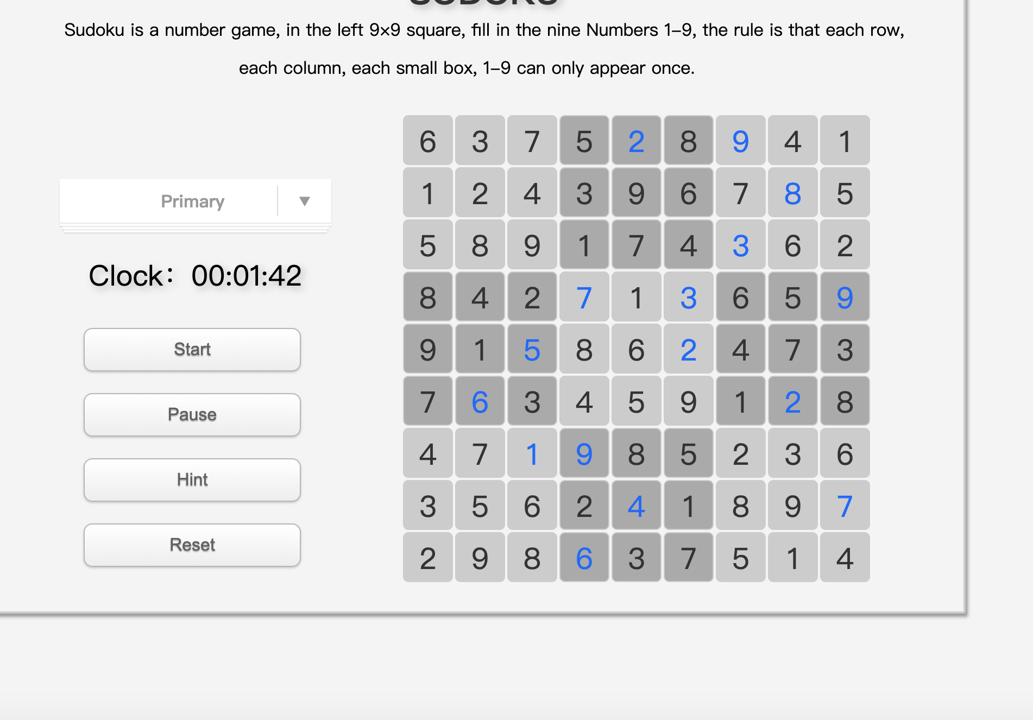
SUDOKU
Second Edition:
The interface is optimized.
Show the rules of the game
Use a drop-down list for difficulty adjustment
Add start, pause, continue button
Add Hint function
Add Reset function
The septum is separated by different shades of gray
The Numbers are colored differently from the Numbers originally generated by the question

Slide 15
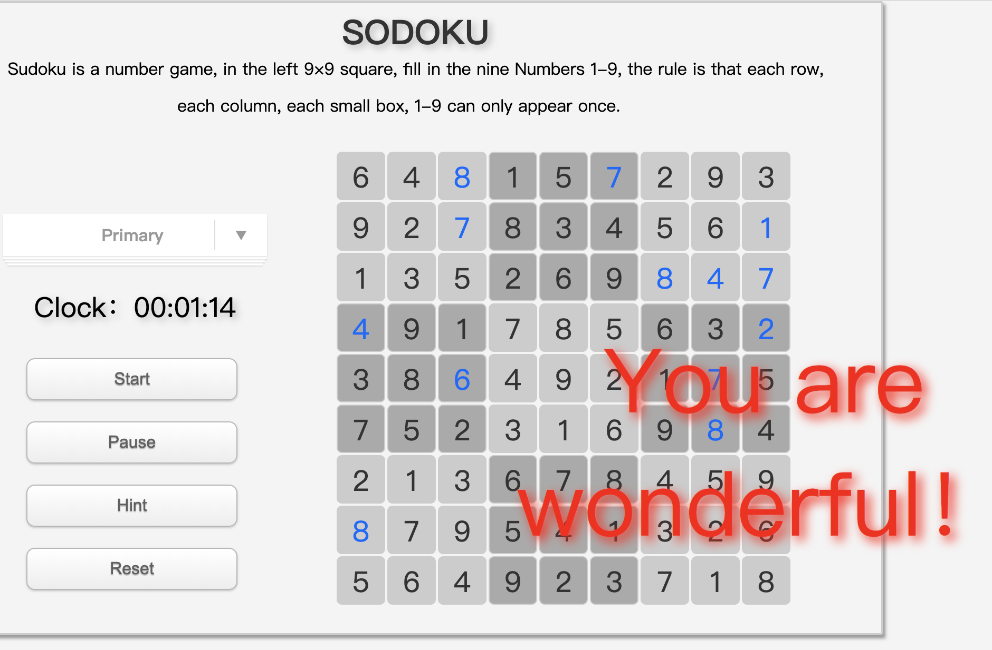
SUDOKU
Second Edition:
When the game is successful, the timer stops.
The screen shows that you are wonderful！

Slide 16
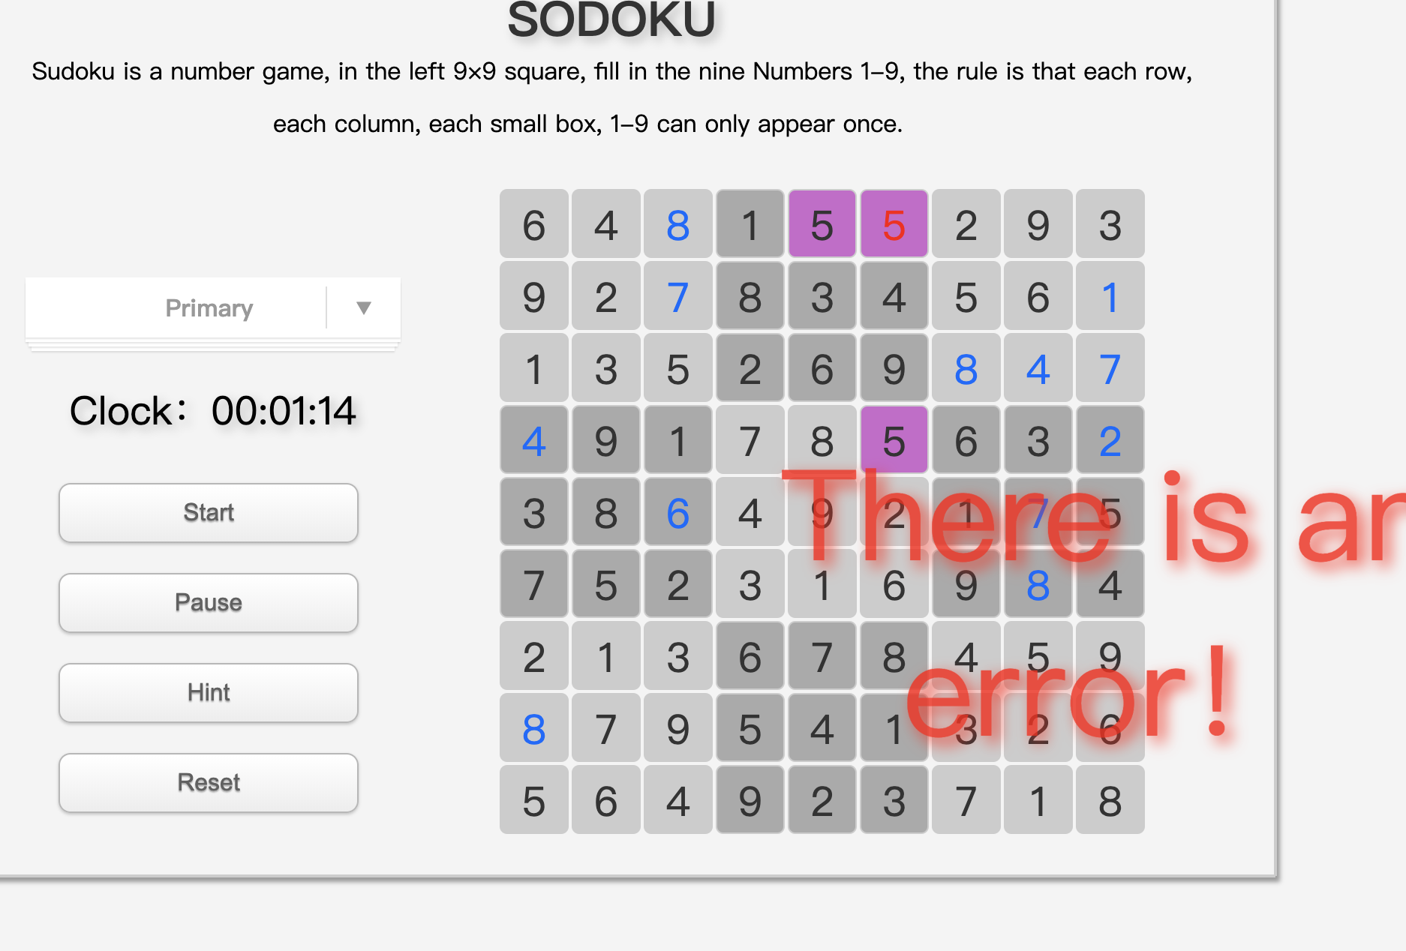
SUDOKU
Second Edition:
If you make a mistake, the system will automatically change the color of the repeated Numbers in the rows, columns, and squares to indicate an error.
When you fill in the last blank and the answer is wrong, the message "there is an error" will appear

Slide 17
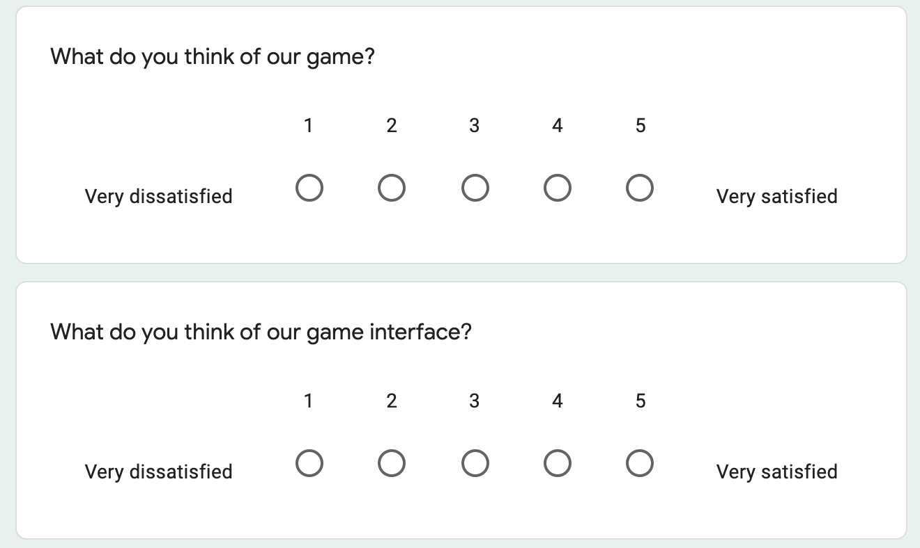
SUDOKU
Survey Result:
We did an online survey in an apartment in jersey city.
The game experience and the game interface were rated respectively
And collected their Suggestions for improvement.

Slide 18
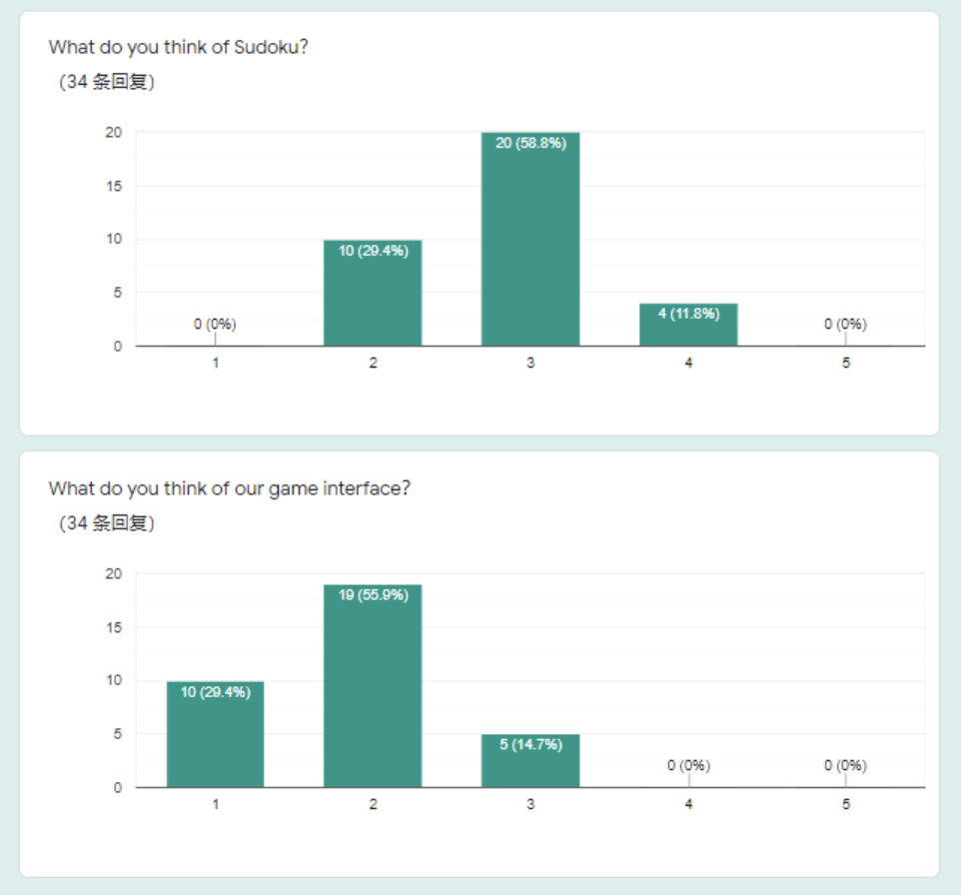

SUDOKU
Survey Result:
We were able to retract 34 of our surveys.
As for the overall reviews of our game, about 60% of users gave us a 3.
For our game's interface, most users only gave us a score of 1-3.

Slide 19
SUDOKU
Survey result：
Through the questionnaire and feedback Suggestions, we got the following summary:
1. Users want the interface to be more beautiful, with a start page.
2. Users want to have their own account, save their personal information, and upload their results to the ranking after the success of the game. And anyone can view the leaderboard, which will make the game more competitive.
3. Users hope to enhance the game experience. When there is an error in filling in the blank, the system can report an error to provide convenience for players.
4. Users want to be able to enter 1-9 Numbers by mouse instead of just typing them on the keyboard.

Slide 20
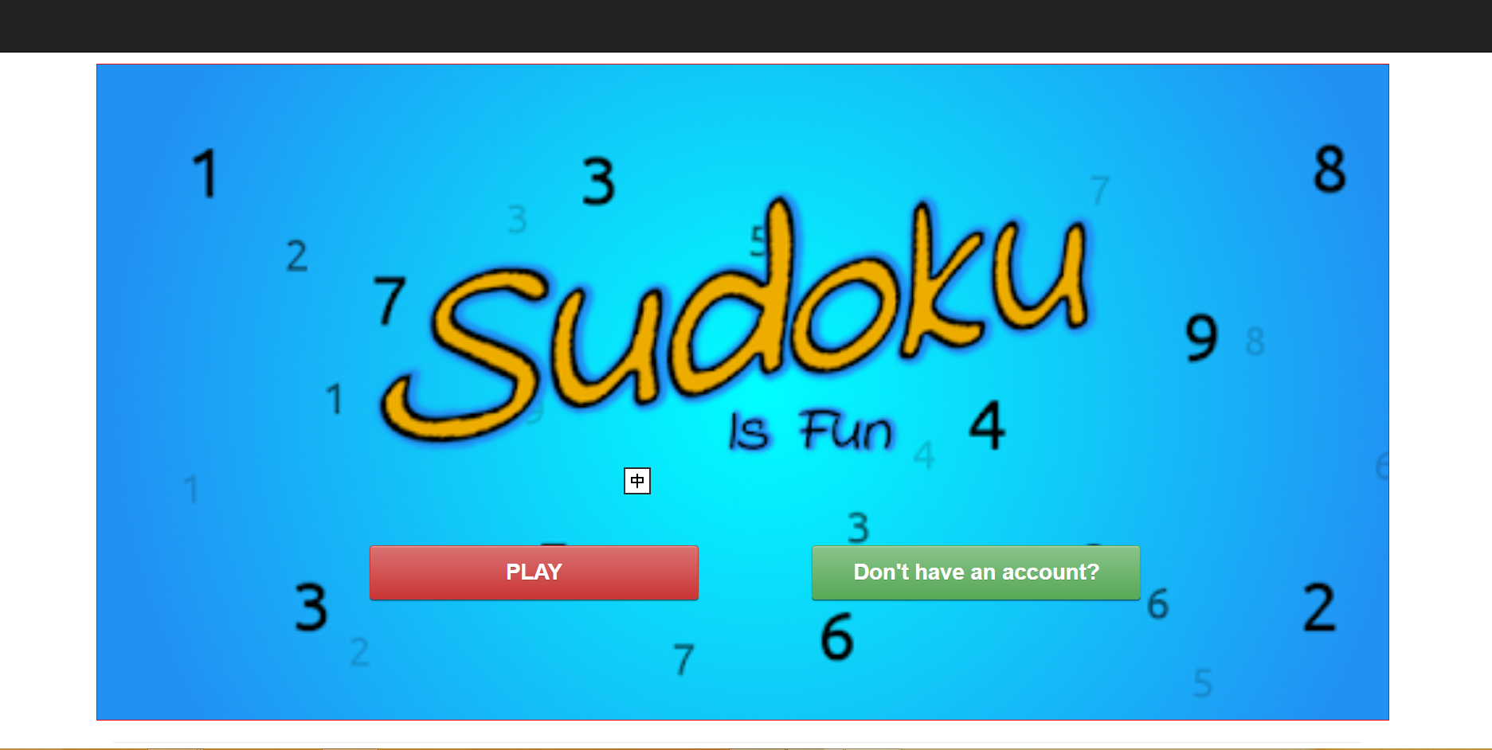
SUDOKU
Final Edition:
We designed a home page where users can choose to log in to start the game.
If you don't have an account, you need to sign up for one of your own.

Slide 21
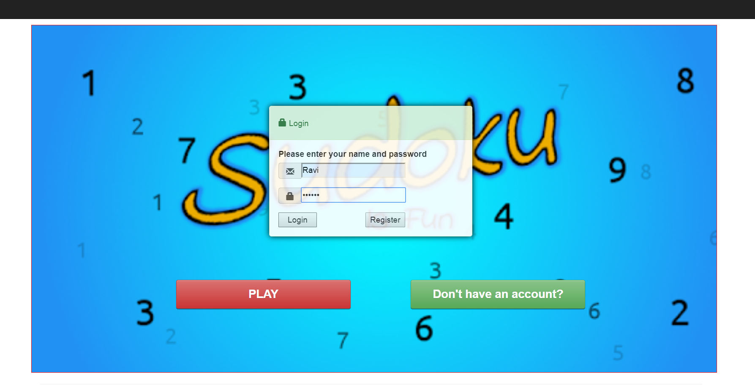
SUDOKU
Final Edition:
If you are not logged in, click to start the game and a login dialog box will pop up. After entering the username and password, you can log into the game system.
If you have already logged in, your user information will be stored in session for 30 minutes.

Slide 22
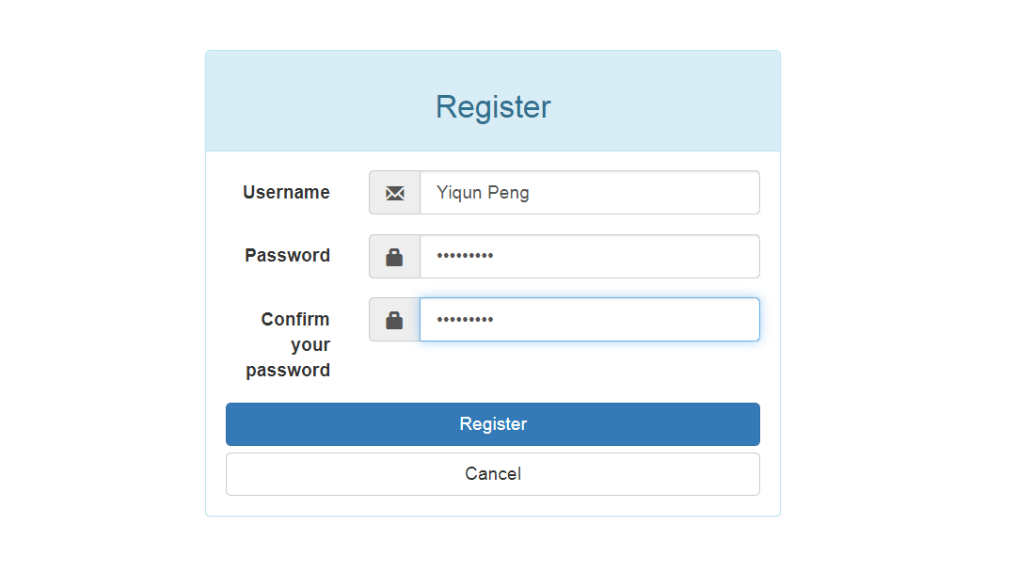
SUDOKU
Final Edition:
If you don't have an account, you can choose to register as a new user. After that, your registration information will be saved in the database.

Slide 23
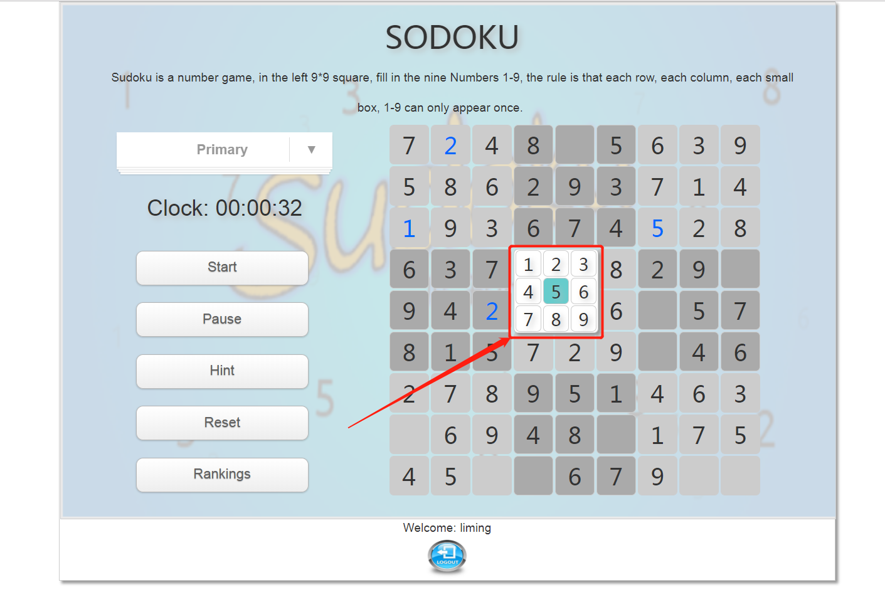
SUDOKU
Final Edition:
We beautify the background interface of the game.
Added a keypad that lets you type Numbers with mouse clicks instead of just using the keyboard (see figure).
At the bottom of the interface, a logout button was added to facilitate players to log out and switch users.

Slide 24
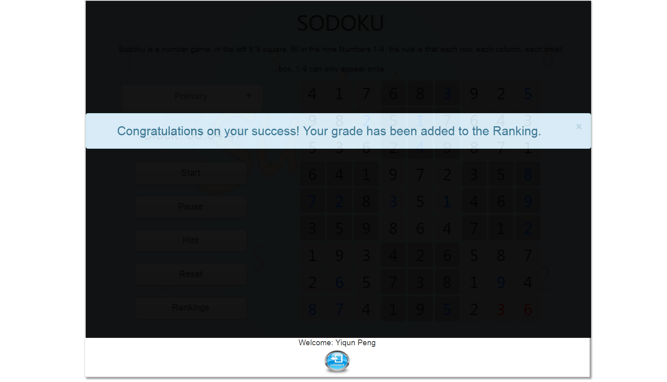
SUDOKU
Final Edition:
When the player clears the level, a success message appears and a black mask layer is displayed to prevent the player from continuing.
Meanwhile, user information and customs clearance time will be recorded into the database

Slide 25
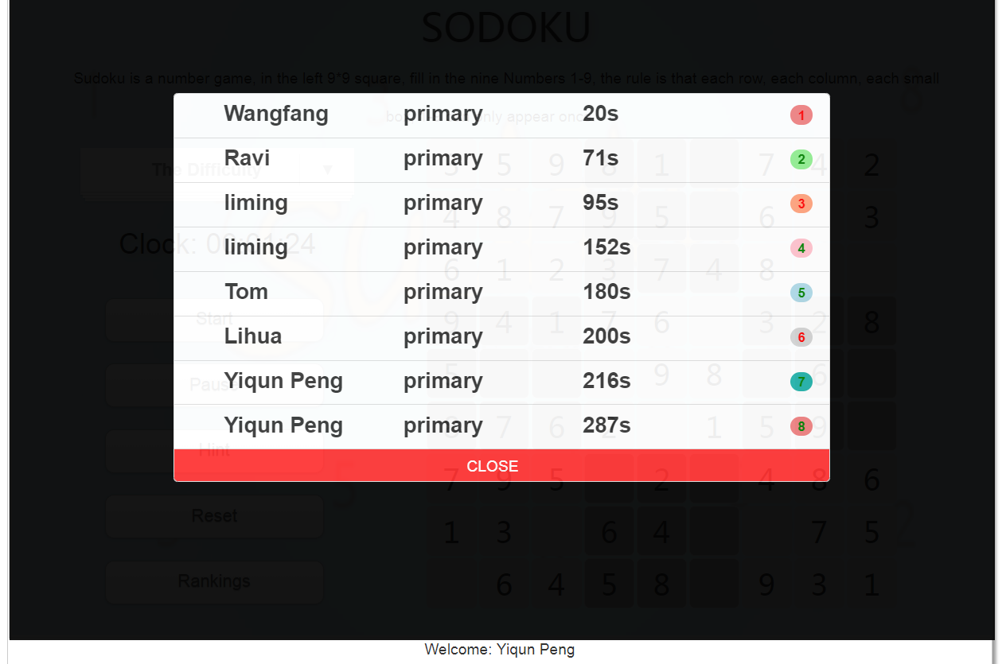
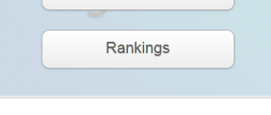
SUDOKU
Final Edition:
If the record is in the top eight, the user's name, time and difficulty will appear in the ranking.
Players can click the Ranking button at any time during the game to check the Ranking information.

Slide 26
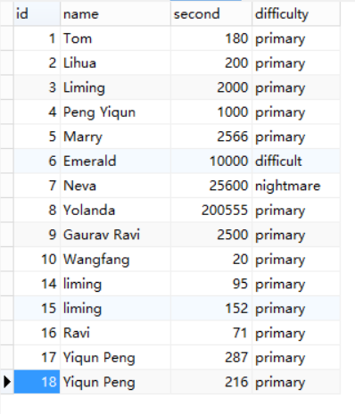
SUDOKU
Final Edition:

Slide 27
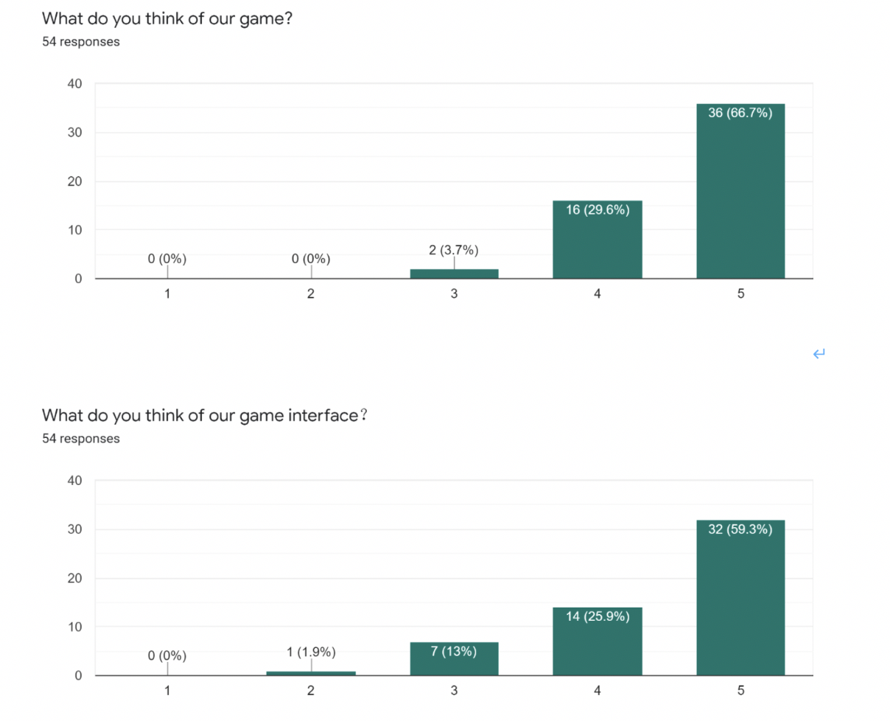
SUDOKU
Final Survey Result:
We were able to retract 54 of our surveys.
Compared with the results of the second survey, our user rating has significantly improved. Most users give 4-5 for the overall design and the interface.

Slide 28
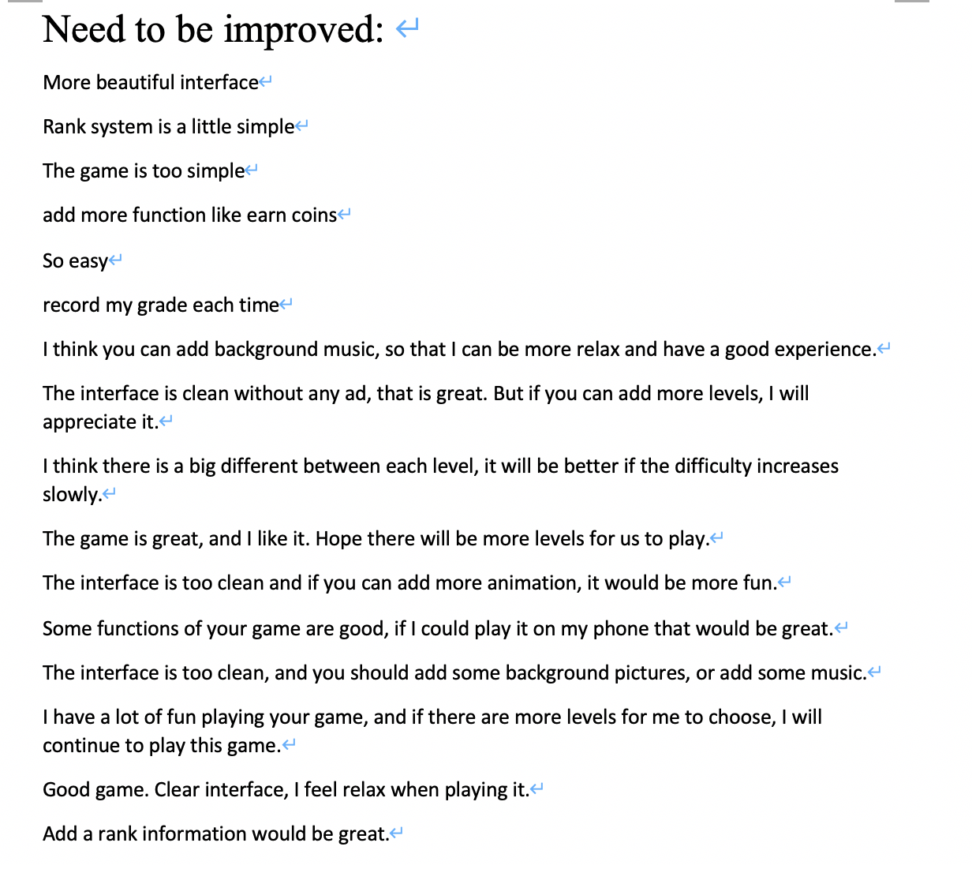
SUDOKU
Final Survey Result:
At the same time, we have received new feedback and Suggestions to further improve the game in the future.

Slide 29
SUDOKU
PAR:
Perception : We designed a simple and easy-to-understand UI, put all the function buttons on one side, and put Sudoku games on the other side. This is convenient for users to use various functions of the product while doing Sudoku.
Attention: All function keys are very eye-catching
Retention: We have designed the simplest difficulty so that novices can understand the Sudoku rules. At the same time, we also have a reminder function to help users when they encounter difficulties

Slide 30
SUDOKU
Microinteraction:
If the user successfully solves the current Sudoku problem, we will pop up the "congratulation" prompt. Conversely, if the user enters the wrong number, we will pop up the "There is an error" prompt

Slide 31
SUDOKU
Tidwell Patterns:
Microbreaks: Each game can be paused. When the player wants to play before continuing, the timer stops during the pause. Incremental
improvement: Through survey questionnaires and opinion interviews, we summarize the game functions and interface prototypes that users want.
Streamlined repetition: Divide the game into different levels of difficulty, each difficulty gradually, but the gameplay is the same. The user does not need to log in again after entering the game because we saved the user information in the session.
Instant Gratification: Each game is successfully cleared, the system will upload the clearance record to the leaderboard, which increases the player's immediate satisfaction and competitiveness. Minimal Information: Players can view the leaderboard changes in real time during the game. You can view hints when you have difficulty solving problems.
Optimizing Flow: The game uses a timer to record the clearance time, quantifies the player's score based on the clearance time, and refreshes the game leaderboard.

Slide 32
SUDOKU
potential drawbacks: 1.The number of Sudoku questions is small, and the logical ability of users cannot be significantly improved
2.The game cannot save the progress of the game, the user must start again every time he logs in.
3. The game only works on the PC side of the web page, not on the mobile phone.
4.No sound effect may cause the use process to be boring

Slide 33
SUDOKU
Running environment: Develop technologies and tools:
The Workspace: the Eclipse IDE
Version control: Google docs
Language: JSP, Javascript, java beans, HTML
Server: Tomcat 7.0
Database: MYSQL 5.6.33
Research tool: Google form
Operating system: Windows
The JDK: JDK 1.8.0 _60
Memory: 1G
Hard disk: 100m
Browsers: IE 8.0 or above, chrome 8.0 or above
Installation process:
Import the database file into MYSQL database, install JDK 1.8.0_60, install Tomcat 7.0 server, use Eclipse to import the project, and run on Tomcat.

Slide 34
SUDOKU
THANK YOU!

